Slide 1



MSc Project (COMP702)
Dense Reinforcement Learning for safety validation of autonomous vehicles
Student
Vikhyat Bisht 201687684
Primary Supervisor
Wiley Ruan
Secondary Supervisor
Xiaowei Huang
Notes:
Hi , My name is Vikhyat, I am here to present my progress on my research project
‘Dense reinforcement learning for safety validation of autonomous vehicles’
the presentation has 6 slides
Overview : This slides covers the “What and Why part of the Project”.
What are we going to do in this Project and why are we doing it. We all know what is Autonomous Vehicles (Its been 20 years when the first AV research and development was started)and why safety validation of autonomous vehicles are important before launching them in the real commercial world.
We are going to talk about the major PROBLEMS that we face during safety validations of AV.
THE 2 MAJOR ASPECTS TIME and DATA .THE RARITY OF THE INCIDENTS THAT HAPPEN IN THE REAL WORLD MAKES IT VERY DIFFICULT TO TRAIN AN AV. THE CRITICAL STAGES ARE SO RARE THAT IS ALMOST GET LOST IN THE LOADS OF NORMAL OR GENERAL DRIVING SCENARIOS , IT ALSO REFERS TO THE CURSE OF RARITY.
THE TIME TAKEN TO TO FIND THESE RARE CONDITION AND VALIDATE THEM TO TRAIN THE THE VEHICLE INCREASES THE COST OF TRAINING.
SO OUR PURPOSE OF THIS PROJECT IS TO MAKE AN RL MODEL WHICH CAN VALIDATE THE SAFETY OF AV.
RL IS THE MACHINE LEARNING TYPE IN WHICH THE AGENT LEARNS WHILE INTERACTING WITH THE ENVIRONMENT.
THE AV IS OUR AGENT AND ENVIRONMENT CONSISTS OF VARIOUS ACTORS SUCH AS STREET LIGHTS , OTHER AV VEHICLES, PEDESTRIANS.
WE ARE USING AN OPEN SOURCE SIMULATION ENVIRONMENT that CAN simulates real-world driving situations.

Slide 2
Table of Content
Overview Workflow Initial System Design Project Plan User Interface Model Risks

Slide 3
OVERVIEW
AIM
Creating a RL Model for safety validation of AV.
What is Safety Validation of Autonomous Vehicle and Why is it important ?
What is Reinforcement learning and Why are we using it for safety validation of AV ?
Notes:
Overview : This slides covers the “What and Why part of the Project”.
What are we going to do in this Project and why are we doing it. We all know what is Autonomous Vehicles and why safety validation of autonomous vehicles are important before launching them in the real commercial world.
We are going to talk about the major PROBLEMS that we face during safety validations of AV.
THE 2 MAJOR ASPECTS TIME and DATA .THE RARITY OF THE INCIDENTS THAT HAPPEN IN THE REAL WORLD MAKES IT VERY DIFFICULT TO TRAIN AN AV. THE CRITICAL STAGES ARE SO RARE THAT IS ALMOST GET LOST IN THE LOADS OF NORMAL OR GENERAL DRIVING SCENARIOS , IT ALSO REFERS TO THE CURSE OF RARITY.
THE TIME TAKEN TO TO FIND THESE RARE CONDITION AND VALIDATE THEM TO TRAIN THE THE VEHICLE INCREASES THE COST OF TRAINING.
SO OUR PURPOSE OF THIS PROJECT IS TO MAKE AN RL MODEL WHICH CAN VALIDATE THE SAFETY OF AV.
RL IS THE MACHINE LEARNING TYPE IN WHICH THE AGENT LEARNS WHILE INTERACTING WITH THE ENVIRONMENT.
THE AV IS OUR AGENT AND ENVIRONMENT CONSISTS OF VARIOUS ACTORS SUCH AS STREET LIGHTS , OTHER AV VEHICLES, PEDESTRIANS.
WE ARE USING AN OPEN SOURCE SIMULATION ENVIRONMENT that CAN simulates real-world driving situations.

Slide 4
OVERVIEW
OBJECTIVES
Setting up the simulation environment
Developing the RL model
Sensor integration implementation:
Evaluation and testing
Reporting and documentation
Notes:
OBJECTIVES
Setting up the Simulation Environment: Use the CARLA simulator, an open-source, highly accurate platform for autonomous vehicle research. Within the simulator, link the pedestrian agents with the autonomous cars.
Developing the Reinforcement Learning Model: Use a reinforcement learning technique that is appropriate for teaching autonomous cars. Establish a suitable incentive system that promotes defensive driving. In the CARLA simulation environment, train the model.
Sensor integration implementation: LIDAR, RADAR, and camera data should all be included to provide the learning model a thorough understanding of the surroundings.
Evaluation and Testing: Test the trained model under various traffic conditions in the simulator to gauge how well it performs. Success is determined by the decline in traffic infractions, the prevention of crashes, and adherence to traffic regulations.
Reporting and Documentation: Keep track of the project's steps, obstacles, fixes, and outcomes. For both academic and business audiences, provide the findings in a thorough and understandable way, including a complete analysis and performance indicators.

Slide 5
WORKFLOW
HOW are we going to do it ?
Setting Up Environment
Model Development
Training
Testing
Evaluation

Slide 6
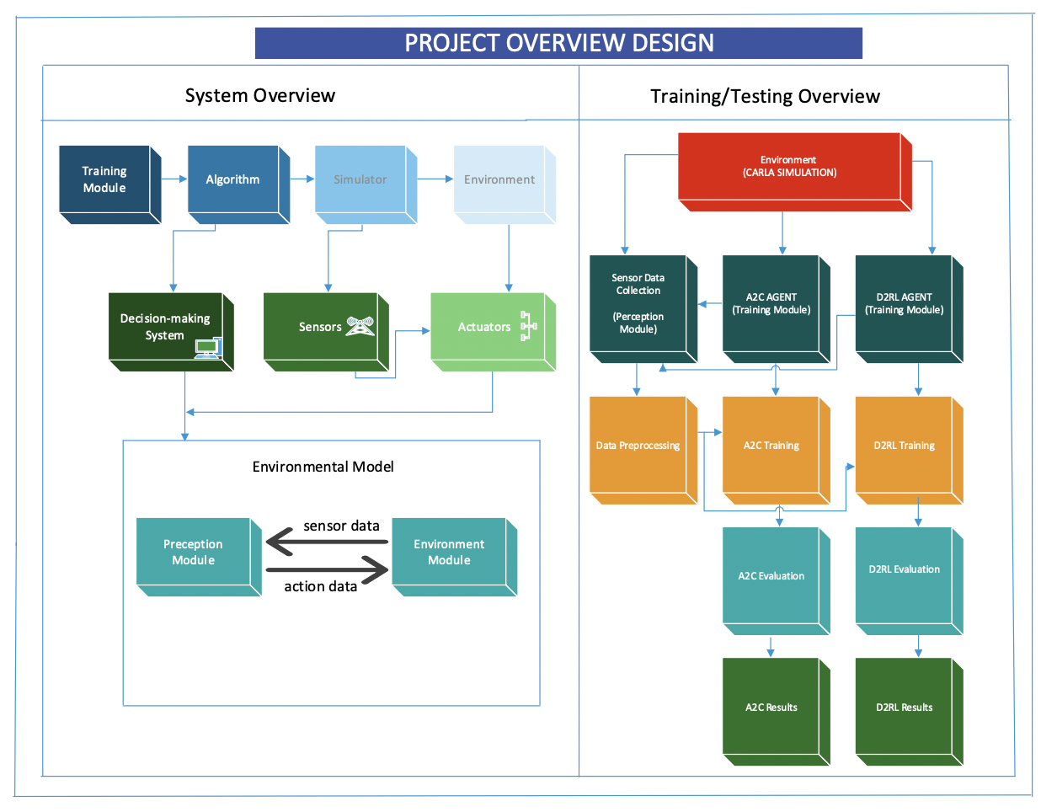
INITIAL SYSTEM DESIGN

Slide 7
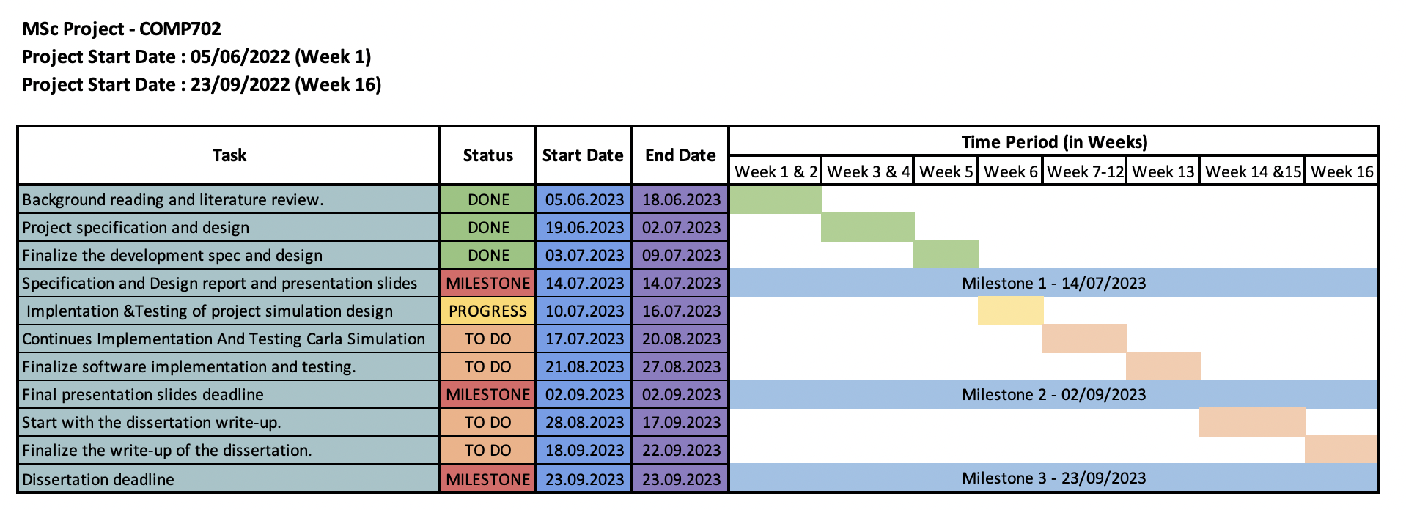
PROJECT PLAN
WHEN are we going to do it ?

Slide 8
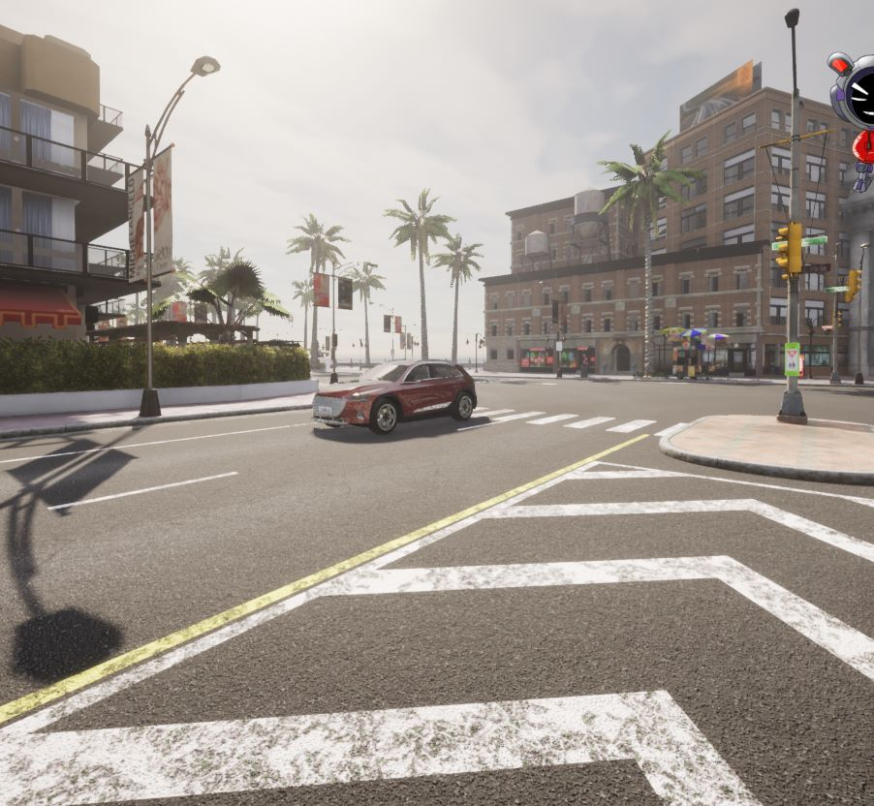
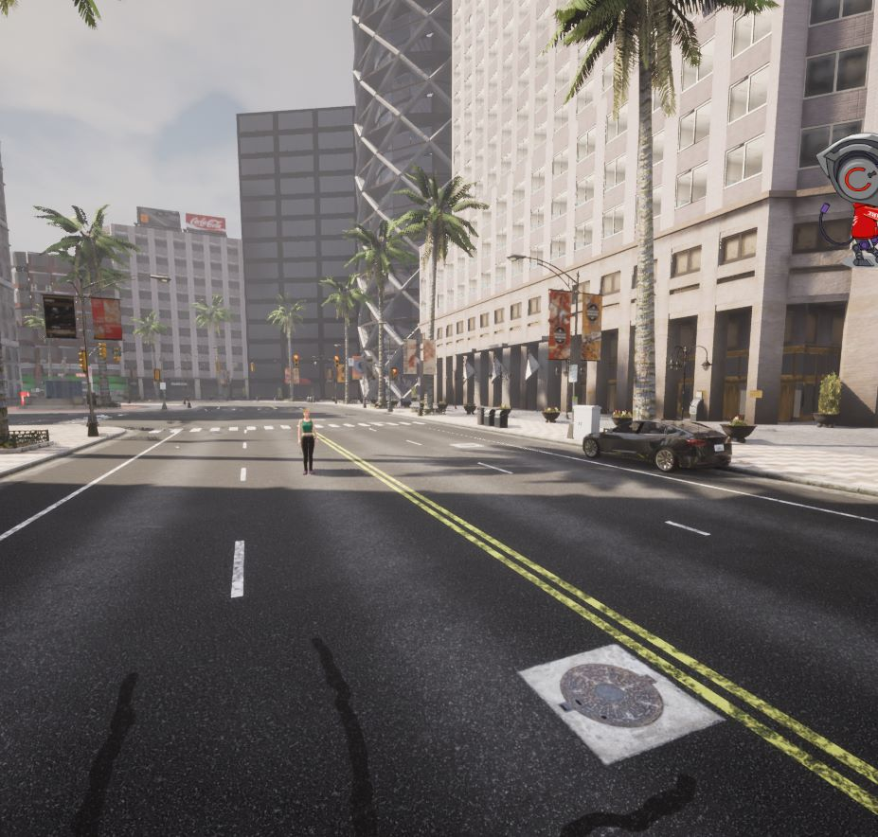
USER INTERFACE MOCKUP

Slide 9
RISKS
Risks | Likelihood | Impact
Hardware failure | Low | High
Software failure | Medium | High
Data loss | Low | Very High
Dependence on external tools/APIs | Medium | Medium
Difficulties with the A2C Algorithm | Medium | Medium
Unexpected Results from AI Training | High | Medium

Slide 10
THANK YOU

